Slide 1


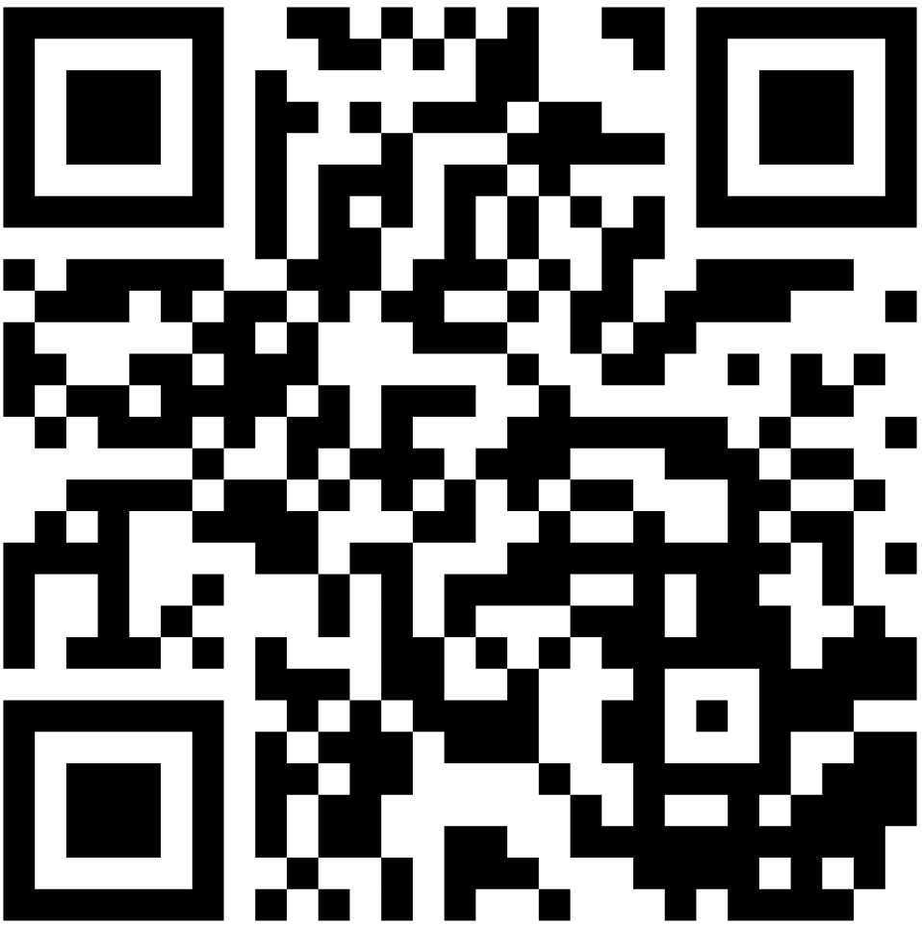
26
Fe
Iron
TO THE FIRE:
STRENGTHENING OCCUPATIONAL HYGIENE
Save
the Date
#AIOH26
BRISBANE CONVENTION & EXHIBITION CENTRE
28TH NOV
02ND DEC

Slide 2
26
Fe
Iron
TO THE FIRE:
STRENGTHENING OCCUPATIONAL HYGIENE
Call for
Abstracts
#AIOH26
BRISBANE CONVENTION & EXHIBITION CENTRE
28TH NOV
02ND DEC

